Slide 1

CREDIT SCORE MODELING
Presented by
Patricia Adolph

Slide 2

CONTENTS
Introduction
Dataset description
Exploratory Analysis
Model building and Evaluation
Conclusion

Slide 3
INTRODUCTION
Credit Score is an indicator of a person's creditworthiness, or their ability to repay debt. It is usually expressed as a number based on the person's repayment history and credit files across different loan types and credit institutions.
The process of modeling means training a machine learning algorithm to predict the labels from the features, tuning it for the business need, and validating it on .
Our motive is to built a model to predict whether the borrower will pass 90 days due to delinquency by learning the probability of default.
We use the PD (probability of Default) analysis approach to determine their expected loss.

Slide 4
INTRODUCTION..
Expected Credit Losses
Credit loss = Contractual cash flows – Expected cash flows(discounted at the original effective interest rate)
Expected credit losses is weighted average of credit losses where weights are probabilities of default
If credit loss is $100 and the probability of default is 2%, expected credit loss is $2 (this is the loss provision recognised)

Slide 5
INTRODUCTION..
Expected Credit Losses
Examining a slice of the customer database (150,000 customers) we find that 6.6% of customers were seriously delinquent in payment the last two years.
ECL = EAD * PD * LGD[Expected credit losses = exposure at default * probability of default * loss given default].
Comparison of the main methods for assessing the probability of default and expected credit losses .

Slide 6
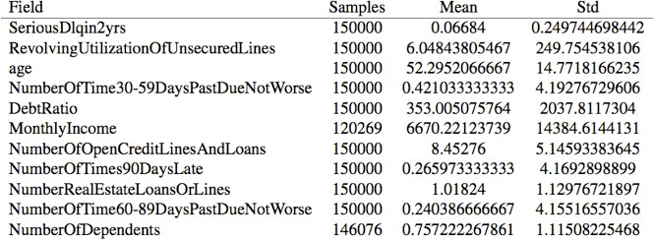
DATASET DESCRIPTION
The data comes from Kaggle's Give Me Some Credit competition, where the dataset has 150,000 sample data and contains 11 variables, as shown in the table below.

Slide 7
DATASET DESCRIPTION..
SeriousDlqin2yrs: Person experienced 90 days past due delinquency or worse
RevolvingUtilizationOfUnsecuredLines: Total balance on credit cards and personal lines of credit except real estate and
no installment debt like car loans divided by the sum of credit limits
Age: Age of borrower in years
NumberOfTime30-59DaysPastDueNotWorse: Number of times borrower has been 30-59 days past due but no worse
in the last 2 years.
Debt Ratio: Monthly debt payments, alimony, living costs divided by monthly gross income
MonthlyIncome: Monthly income
NumberOfOpenCreditLinesAndLoans: Number of Open loans (installment like car loan or mortgage) and
Lines of credit (e.g. credit cards)
NumberOfTimes90DaysLate: Number of times borrower has been 90 days or more past due.
NumberRealEstateLoansOrLines: Number of mortgage and real estate loans including home equity lines of credit
NumberOfTime60-89DaysPastDueNotWorse: Number of times borrower has been 60-89 days past due but no worse
in the last 2 years.
NumberOfDependents: Number of dependents in family excluding themselves (spouse, children etc.)

Slide 8
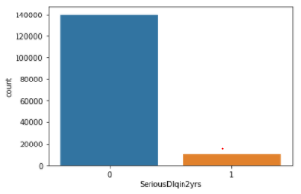
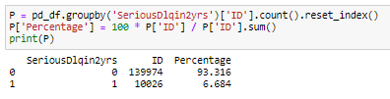
Target variable: SeriousDlqin2yrs
The target variable to predict PD is SeriousDlqin2yrs. From the below figure, It’s evident that the target variable is an unbalanced data.
Unbalanced data will cause the supervised learning algorithm to pay too much attention to the majority of classes and reduce the classification performance; because there are enough data, under-sampling is used; regular regression models and ensemble models are used.

Slide 9
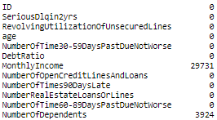
Exploratory Analysis
PD Dataset contain null values due to many reasons such as data is not recorded during the data collection phase, data corruption, etc.
Handling missing values
The following are the number of missing values in the dataset for each feature.

Slide 10
Exploratory Analysis..
Handling missing values
MonthlyIncome
The variable MonthlyIncome has many missing values, so the sample cannot be deleted directly, and there are not too many missing values to directly delete the attributes, so the missing values need to be filled. Here we use random forest prediction. We have developed a python function to impute the missing values for MonthlyIncome using random forest regressor
NumberOfDependents
The Median imputation technique is used to impute missing values on NumberOfDependents variable.

Slide 11
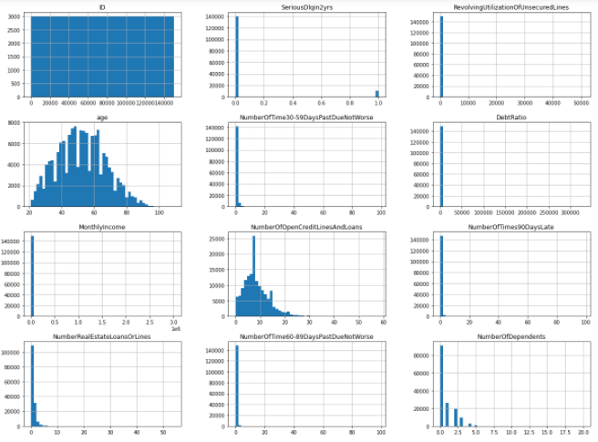
Exploratory Analysis..
Outlier detection and handling
It can be seen that the data distribution of DebtRatio, NumberOfTime30-59DaysPastDueNotWorse, NumberOfTime60-89DaysPastDueNotWorse, NumberOfTimes90DaysLate, NumberRealEstateLoansOrLines, RevolvingUtilizationOfUnsecuredLines prior to removing outliers
are abnormal, and there should be some extreme values.
Here we use box plots to check the distribution of values, and remove extreme values.

Slide 12
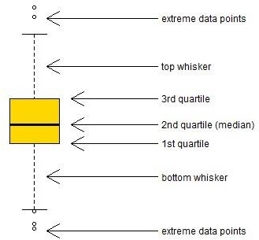
Exploratory Analysis..
Outlier detection using Boxplot
Boxplot:
Displaying the variation of data based on the five number summary, which includes minimum, first quartile, median, third quartile, and maximum.
This plot does not make any assumptions of the underlying statistical distribution.

Slide 13
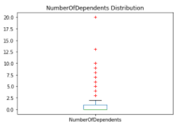
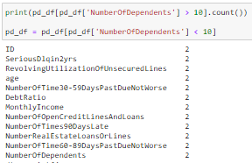
Exploratory Analysis..
Outlier deletion using Boxplot
Any data not included between the minimum and maximum are considered as an outlier. We have observed that the extreme values for NumberOfDependents is greater than 10. We remove those outliers from the dataset.

Slide 14
Exploratory Analysis..
Outlier deletion using Boxplot
Similar boxplot technique has been used to remove outliers from the following features.
Debt Ratio > 8000
MonthlyIncome > 50000
NumberOfDependents > 10
NumberOfTime30-59DaysPastDueNotWorse
& NumberOfTime60-89DaysPastDueNotWorse
& NumberOfTimes90DaysLate > 20
5. NumberRealEstateLoansOrLines > 30
6. RevolvingUtilizationOfUnsecuredLines > 3

Slide 15
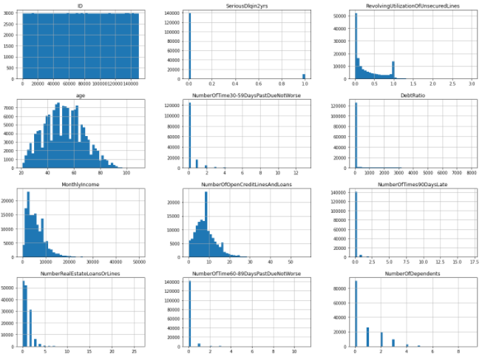
Exploratory Analysis..
Data distribution after handling outliers
It is evident that the data distribution after removing outliers seems to be normal.

Slide 16
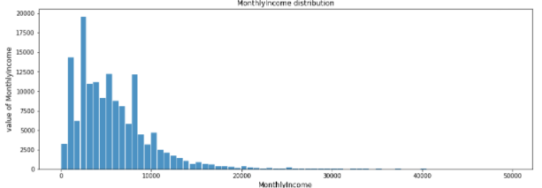
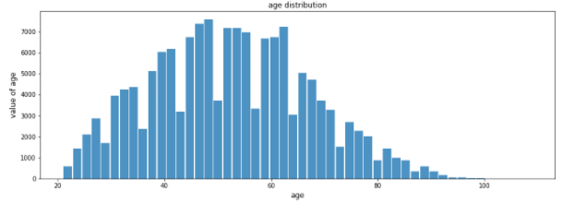
Exploratory Analysis..
Normality of the independent variable
The distribution of customer income and age are shown in the figures. It can be seen that both variables are roughly normally distributed, which is in line with the assumptions of statistical analysis.

Slide 17
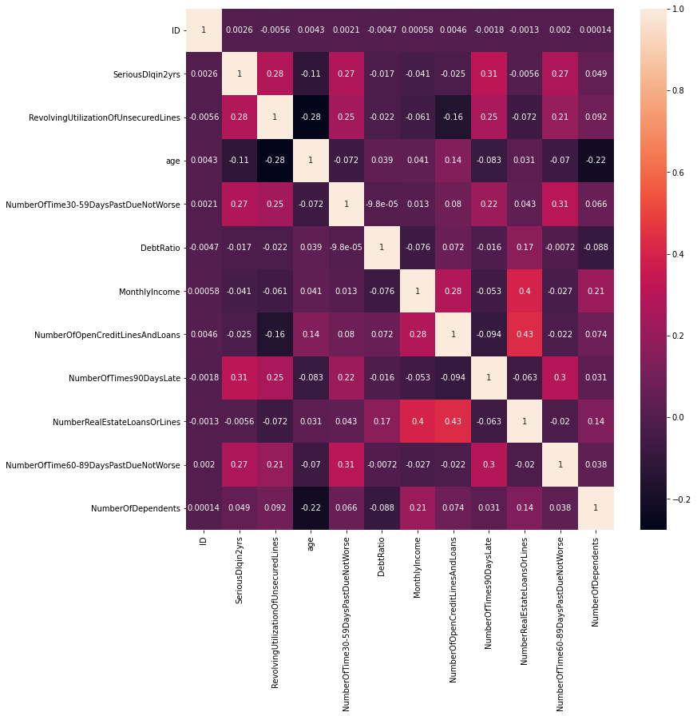
Exploratory Analysis..
Correlation Analysis
The correlation map in-line with the business logic and statistical assumptions.
For example, there is a high correlation between SeriousDlqin2yrs and NumberOfTimes90DaysLate

Slide 18
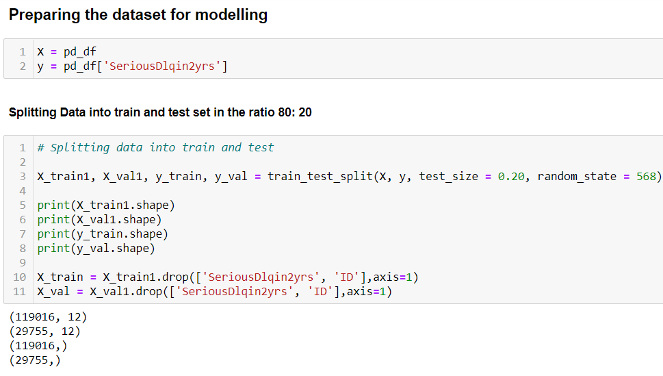
Data Modeling
In this step, we are preparing and splitting the dataset for modelling as train and test set in the ratio 80:20
Train
Test

Slide 19
Machine Learning Models
We have considered the following machine learning models to predict PD.
XGBoost: It is a scalable and accurate implementation of gradient boosting machines which has proven to push the limits of computing power for boosted trees algorithms sole purpose of model performance and computational speed.
Random Forest: A supervised learning algorithm. It is a collection of decision trees and is a powerful technique to use for model prediction and behavior analysis.
Logistic Regression: A technique used to calculate the relationship between two variables. It measures the relationship between the dependent variable with one or more independent variables using a logistic function

Slide 20
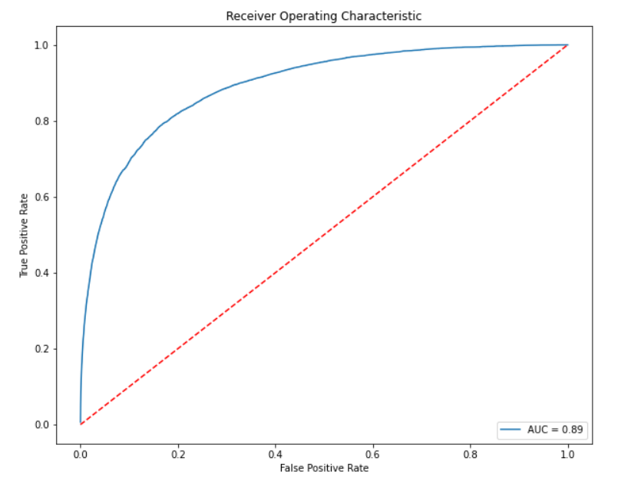
.
.
XGBoost Model
XGBOOST : An advanced implementation of the Gradient Boosting algorithm designed to boost the speed, performance, and accuracy of the model. This technique has the advantage of preventing over-fitting by using a variety of regularizations to even the final weights.
ROC Curve : Classifiers that give curves closer to the top-left corner indicate a better performance.

Slide 21
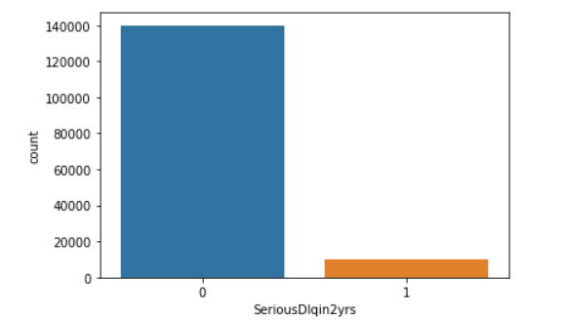
.
.
Random Forest Model
Random Forest: A machine learning technique that's used to solve regression and classification problems. It utilizes ensemble learning, which is a technique that combines many classifiers to provide solutions to complex problems.
Random Forest using SMOTE :
SMOTE- approach to address imbalanced datasets is to oversample the minority class.

Slide 22
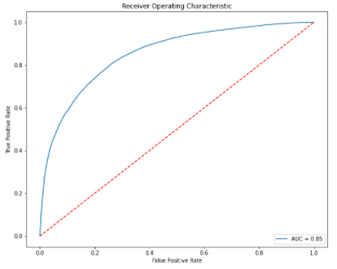
.
.
Random Forest Model..
AUC - ROC: It is a performance measurement for the classification problems at various threshold settings. ROC is a probability curve and AUC represents the degree or measure of separability.
ROC Curve : Classifiers that give curves closer to the top-left corner indicate a better performance.

Slide 23
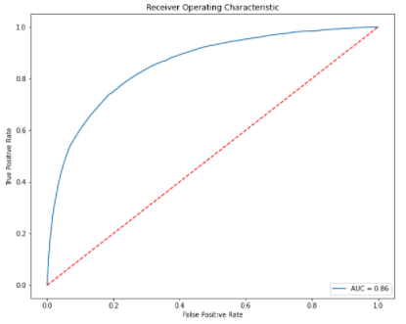
.
.
Logistic Regression Model
Logistic Regression : measures the relationship between dependent variable with one or more nominal, ordinal, interval or ratio-level independent variable using a logistic function.
ROC Curve : Classifiers that give curves closer to the top-left corner indicate a better performance.

Slide 24
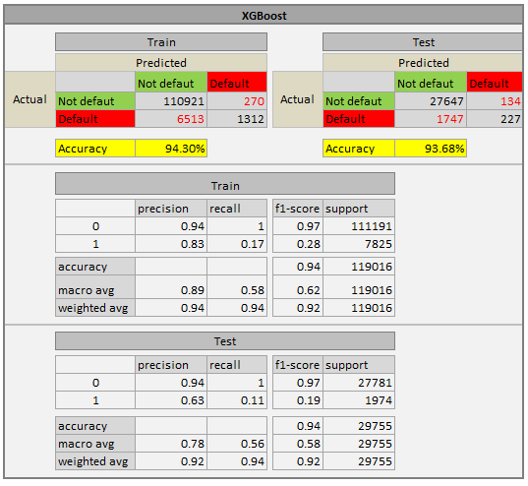

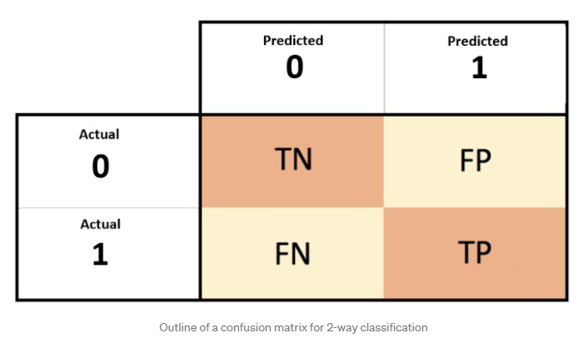
.
.
Model Evaluation & Comparison
XGBoost:
Type 1 error: False Positive
Type 2 error: False Negative

Slide 25
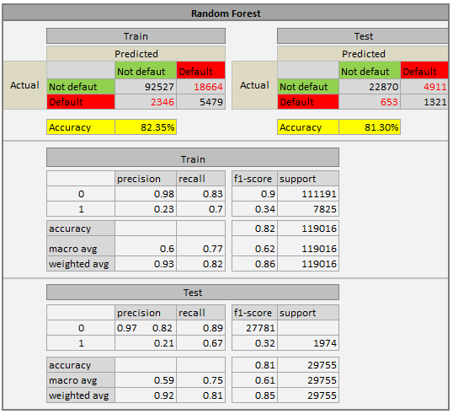

.
.
Model Evaluation & Comparison..
Random Forest:
Type 1 error: False Positive
Type 2 error: False Negative

Slide 26
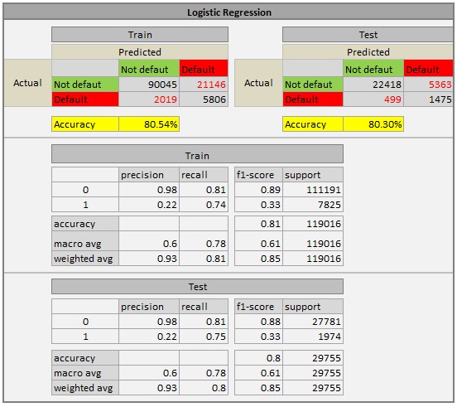

.
.
Model Evaluation & Comparison..
Logistic Regression:
Type 1 error: False Positive
Type 2 error: False Negative

Slide 27
CONCLUSION
.
.
Three models (XGBoost, Random Forest, and Logistic Regression) were build to predict the Probability of Default.
By comparing the accuracy from all the models it is evident that XGBoost gives more accuracy than others
Selected Model - XGBoost: Highly Flexible, High Accuracy rate, uses the power of parallel processing and Faster.
Banks can use this PD model in order to predict Excepted Credit Loss.

Slide 28



